Slide 1
user defined types

Slide 2
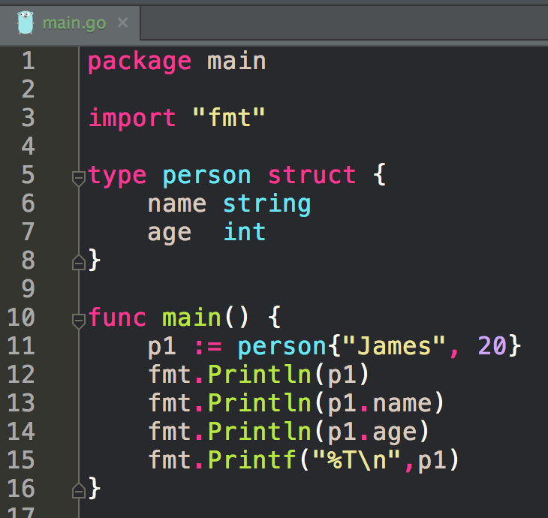
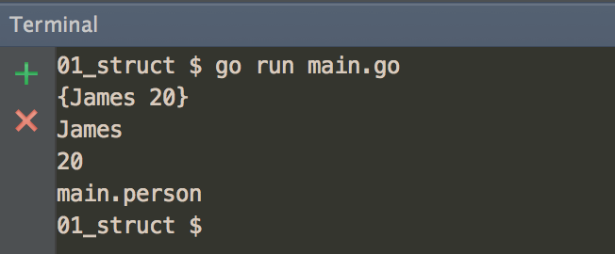
we already saw this code
when looking at structs

Slide 3
user defined types
another example

Slide 4
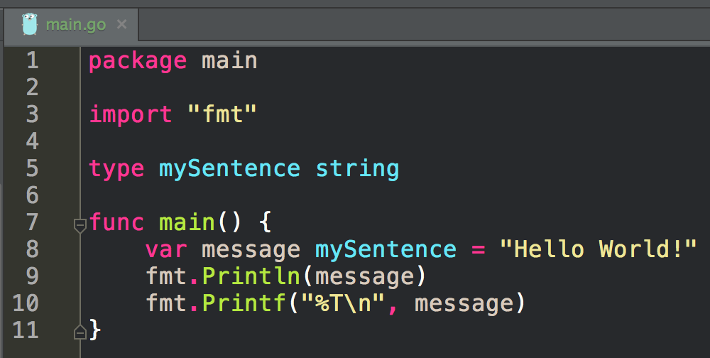
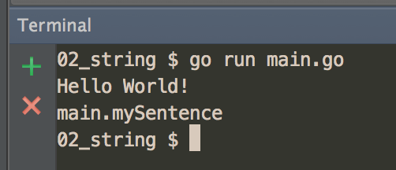

Slide 5
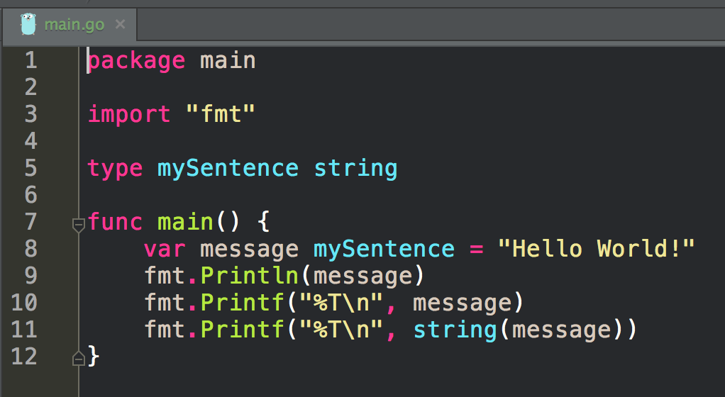
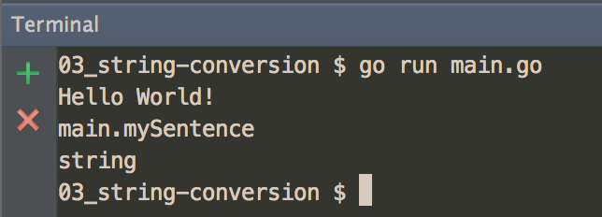
Conversion

Slide 6
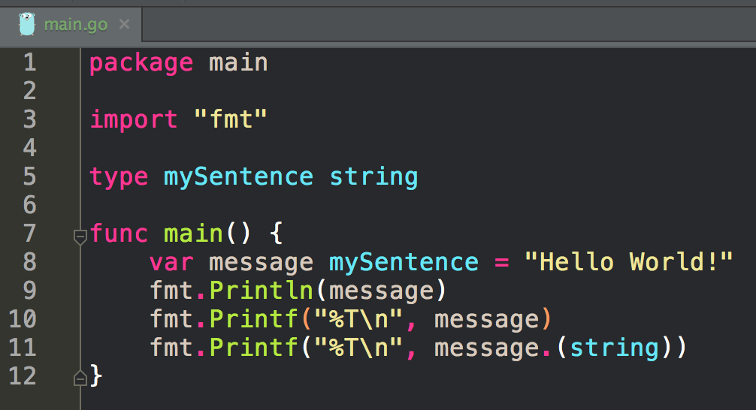
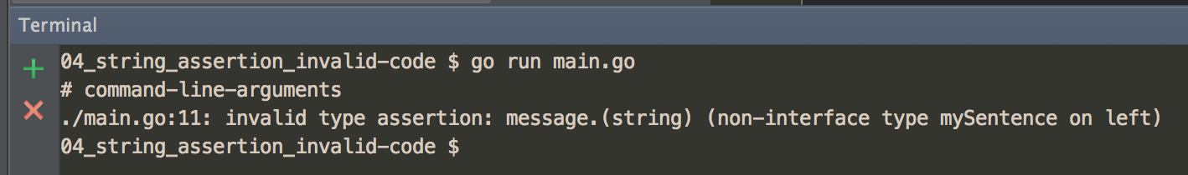
Assertion

Slide 7
type system

Slide 8
Pre-declared vs Composite
Golang by default includes several pre-declared, built-in, primitive types
boolean
numeric
string
Pre-declared types are used to construct other composite types
array
struct
pointer
slice
map
channel

Slide 9
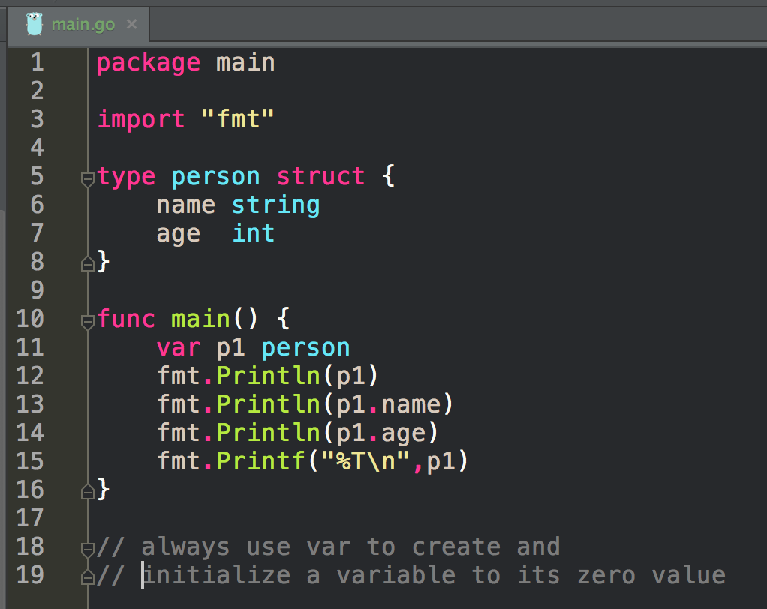
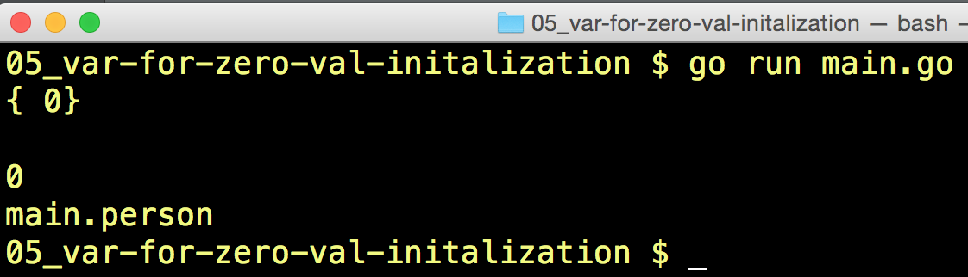

Slide 10
Always use “var” to initialize a variable to its zero value

Slide 11
zero value
false for booleans, 0 for integers, 0.0 for floats, "" for strings
nil for pointers, functions, interfaces, slices, channels, and maps
https://golang.org/ref/spec#The_zero_value

Slide 12
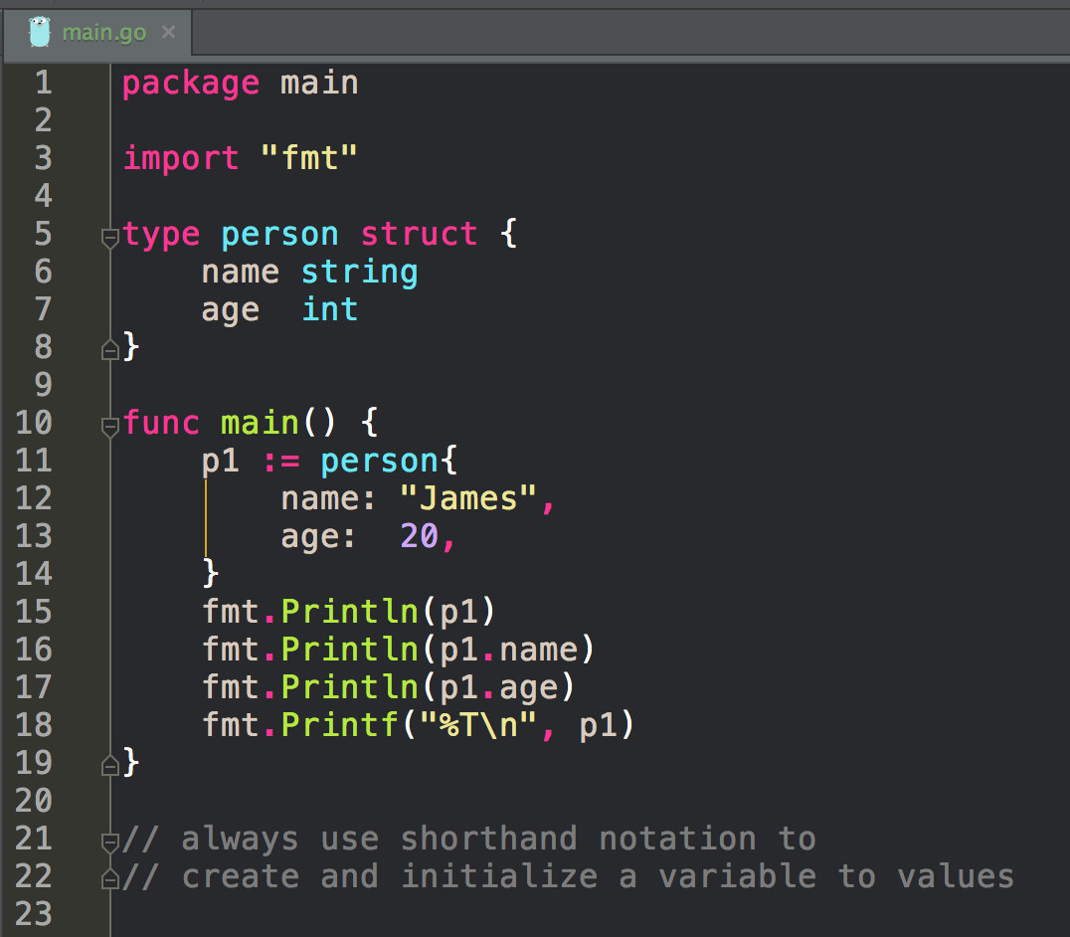
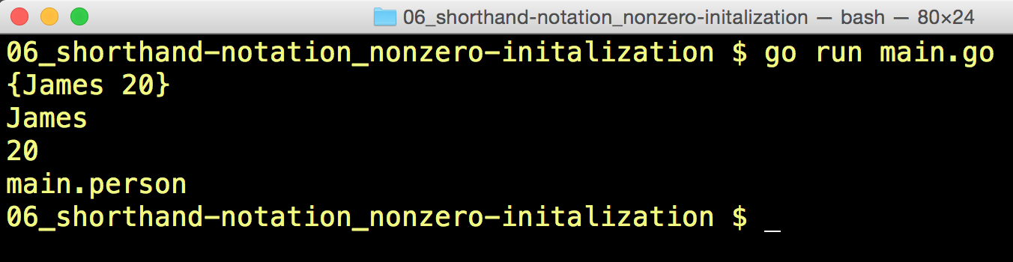
Always use shorthand notation to initialize a variable

Slide 13
N
N

Slide 14
Named vs Unnamed
Named
allow methods
Unnamed / Anonymous
source: Learning Go - Types

Slide 15
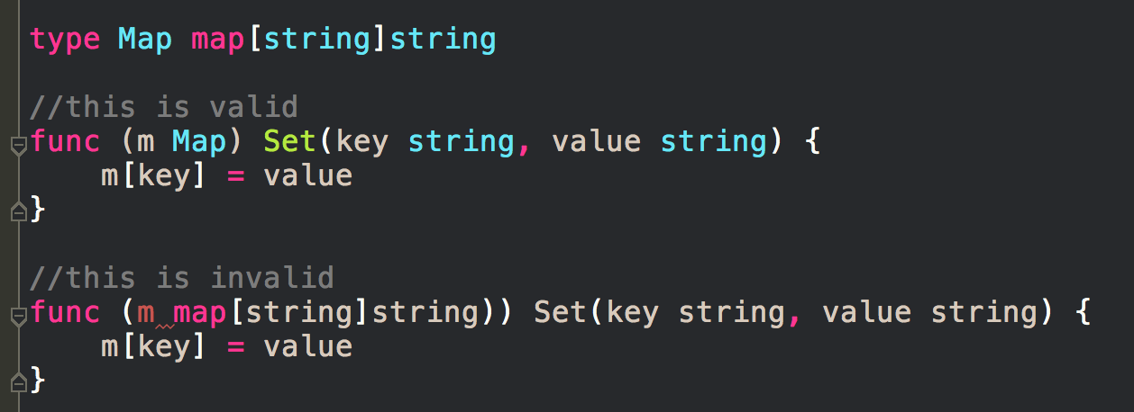
Named vs Unnamed
source: Learning Go - Types

Slide 16
golang spec
let’s continue learning about reading official documentation

Slide 17
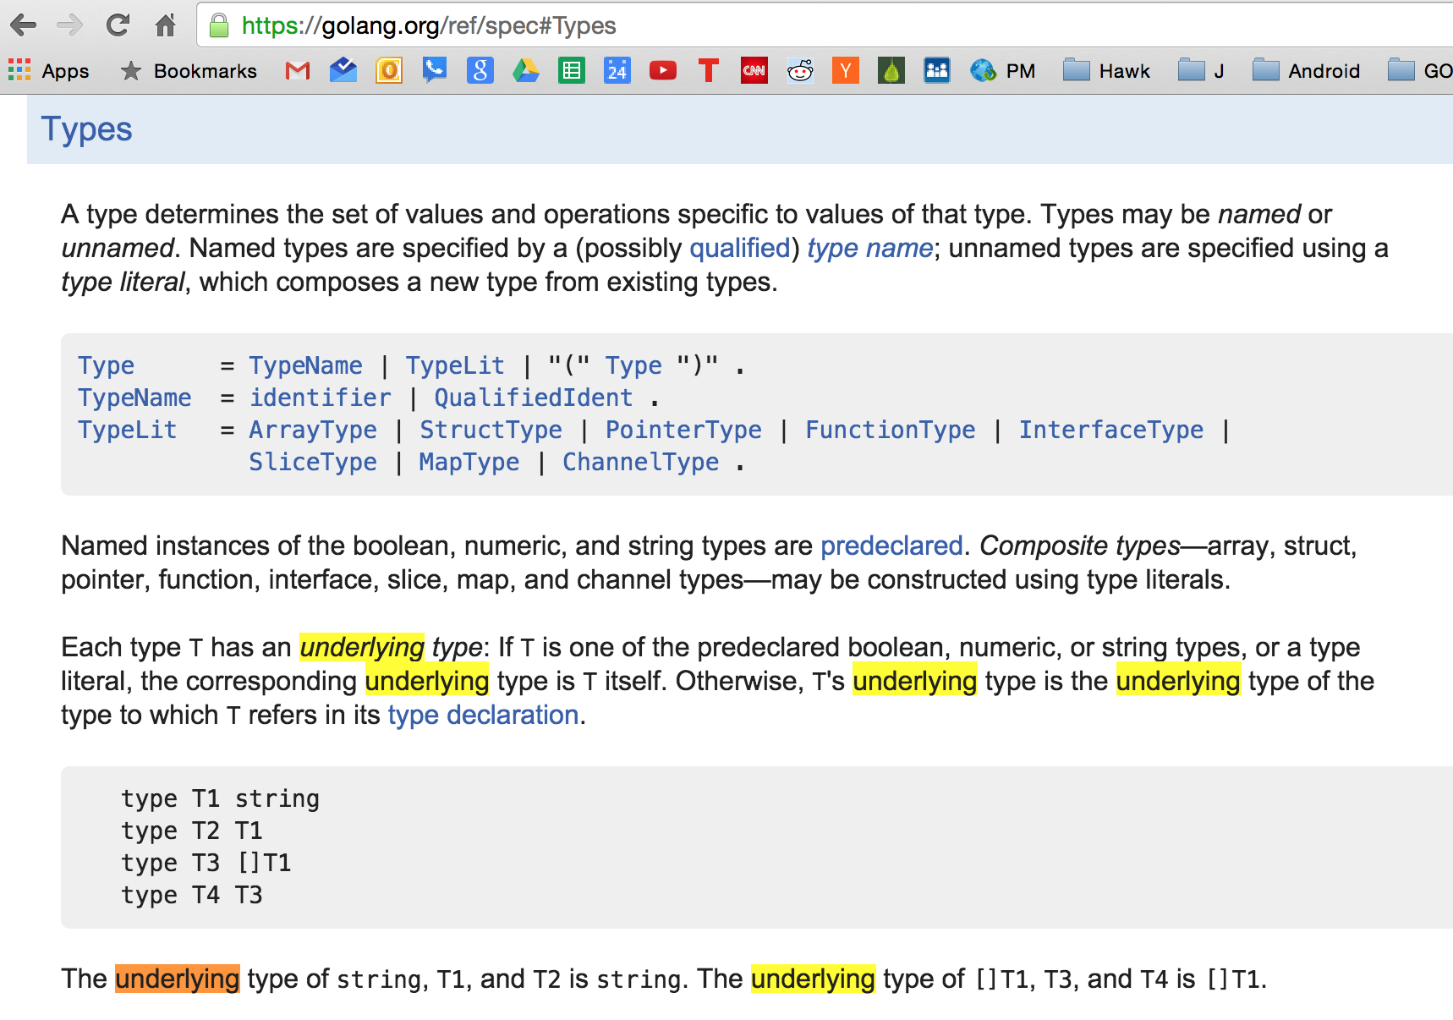
There are “named” and “unnamed” types

Slide 18
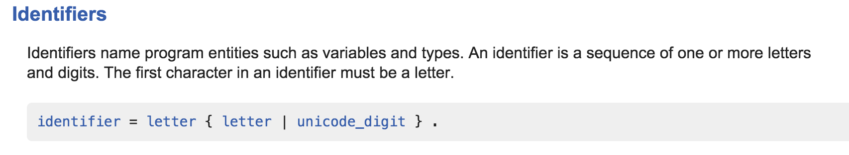
“named” type - you create the identifier (the name)

Slide 19
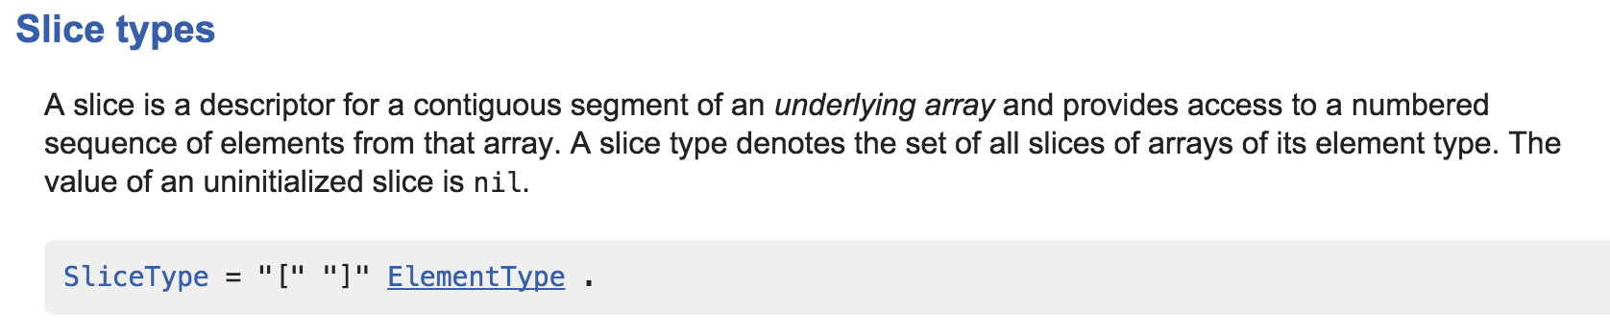

“unnamed” type - use the TypeLit already defined

Slide 20
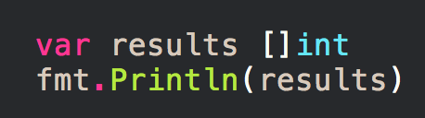
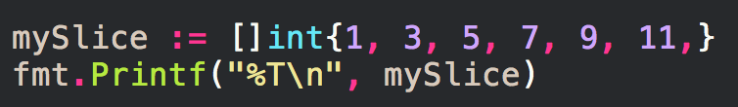


Slide 21
There are “named” and “unnamed” types

Slide 22
example

Slide 23
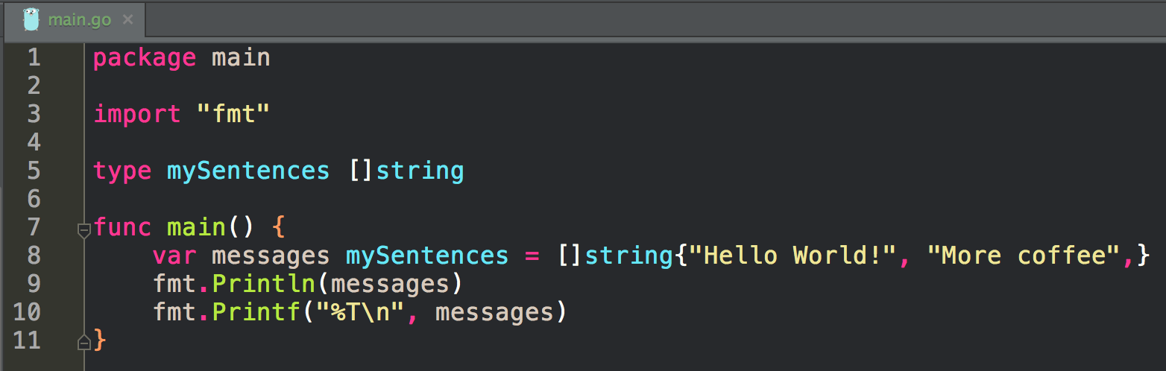
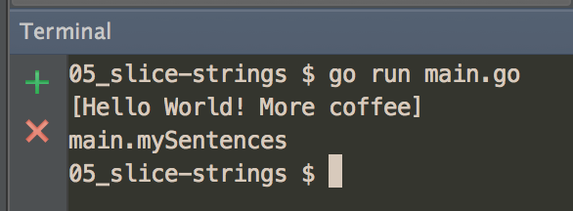

Slide 24
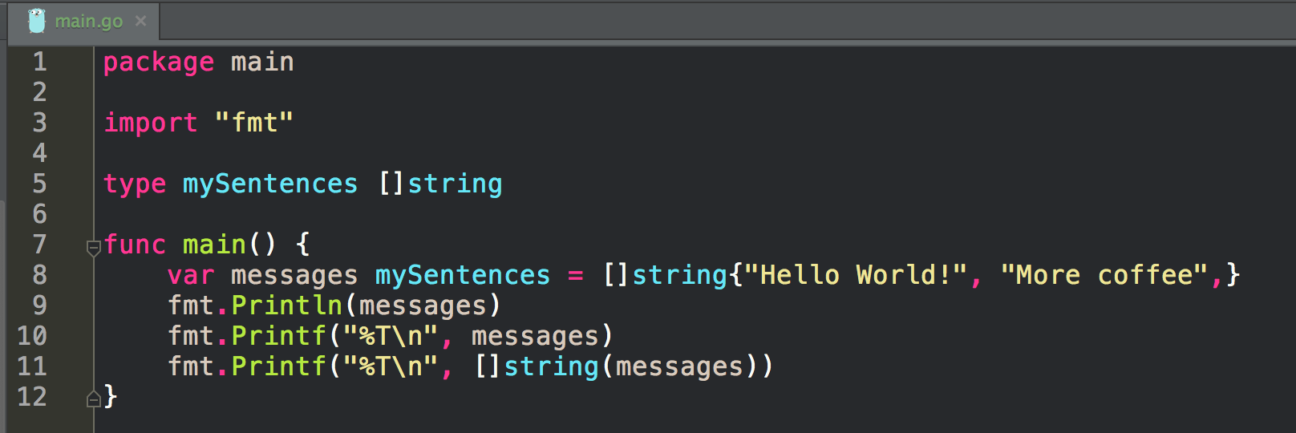
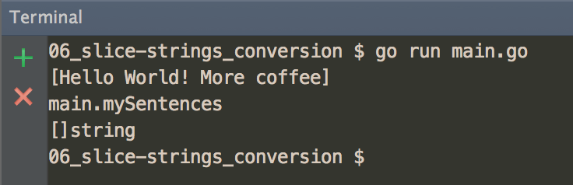
Conversion

Slide 25
Underlying Type
Every type has an underlying type
Pre-declared types and type literals refers to themselves as the underlying type.
When declaring a new type, you have to provide an existing type.
The new type will have the same underlying type as the existing type.
source: Learning Go - Types

Slide 26
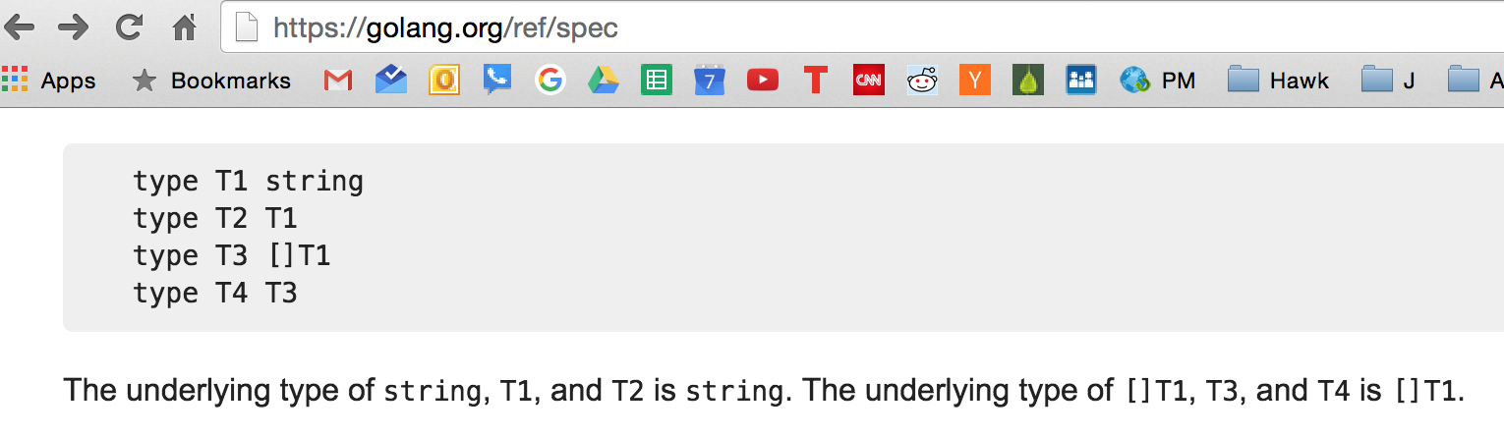

Slide 27
example

Slide 28
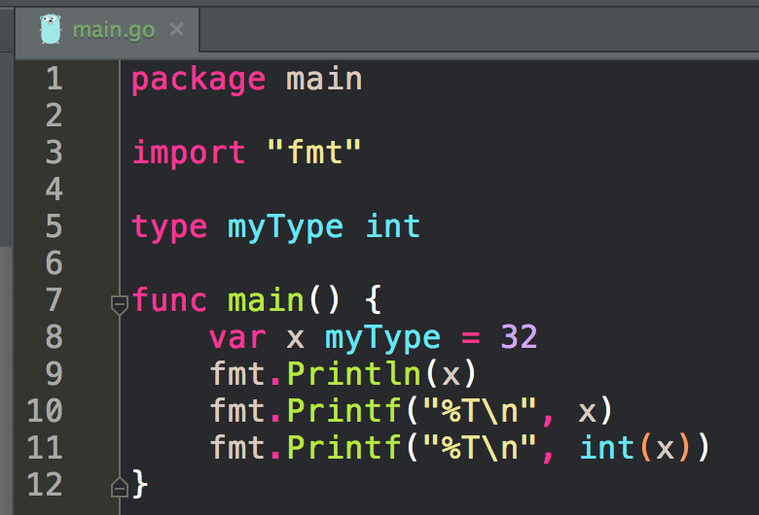
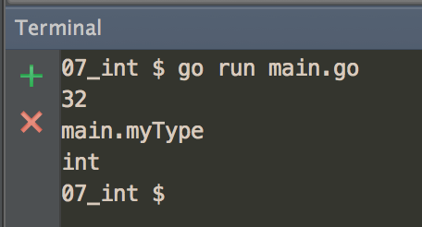
Conversion

Slide 29
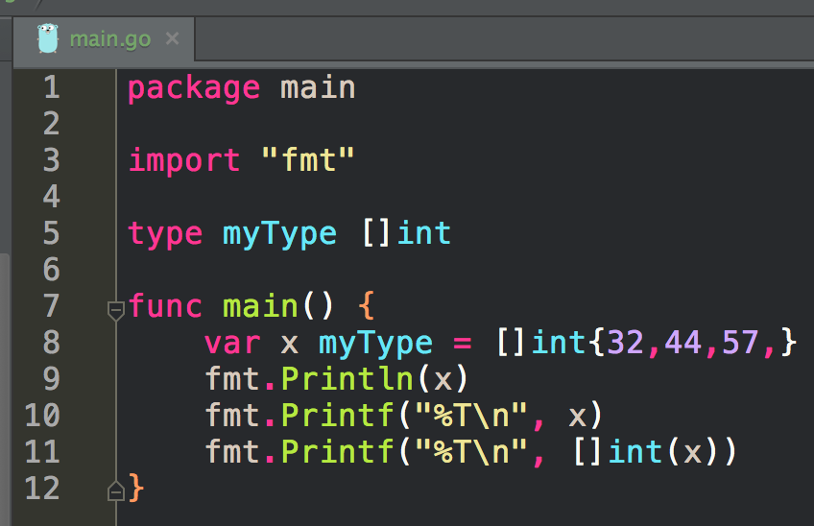
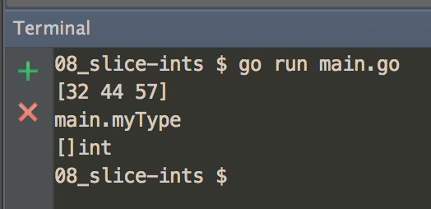
Conversion

Slide 30
exercise
make a program
inside the program, create a type and use it

Slide 31
Review
You can create your own types
your types will have an underlying type

Slide 32
Review Questions

Slide 33
predeclared
Why do you think the word “predeclared” is used when talking about certain types in go?

Slide 34
named
Why do you think the word “named” is used when talking about certain types in go?

Slide 35
composite
Why do you think the word “composite” is used when talking about certain types in go?

Slide 36
unnamed
Why do you think the word “unnamed” is used when talking about certain types in go?

Slide 37
literal
What is the general definition of a literal in programming? Why do you think the phrase “type literal” is used when talking about certain types in go?

Slide 38
named type
Write a program that creates a named typed, attaches a method to it, and then uses that method.

